Slide 1

FOOD
NEXT
DOOR
Usability Testing & Implementation
By
ARPITH MUDDI - 11012490
GUNJAN KADU - 11012377

Slide 2
Today's Discussion
Motivation
Concept
Design Process
Implementation
Analysis
Lessons Learnt

Slide 3

Motivation
Understand & Implement the concepts of UI/UX Design, Development and Testing learnt through out this module, in developing an Idea to an MVP.
CONCEPT

Slide 4


Backdrop
It’s all about Food.
Order food. Go in search of it.
Platforms exists to order food. Not the other way round.

Slide 5

Concept
Digital Platform - Buy & Sell Food
Order Food Online.
Signup as Chef – Offer food online.

Slide 6

Competitors
Similar Platforms: Zomato, Liferando, Delivery Hero, Uber Eats, FoodPanda

Slide 7
BRAIN STORMING
ANALYSIS
FUNCTIONAL REQUIREMENTS
Design Process
DESIGN THINKING
MOCKUPS
WIREFRAMES

Slide 8
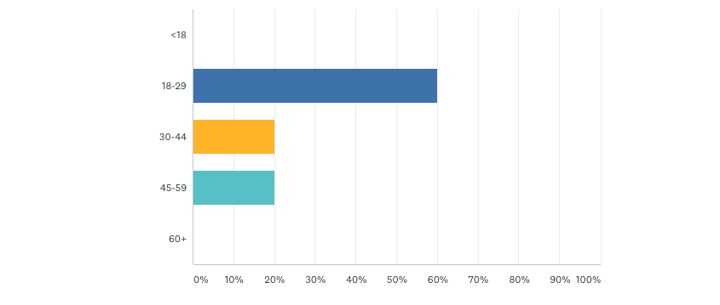
SURVEY
Age

Slide 9
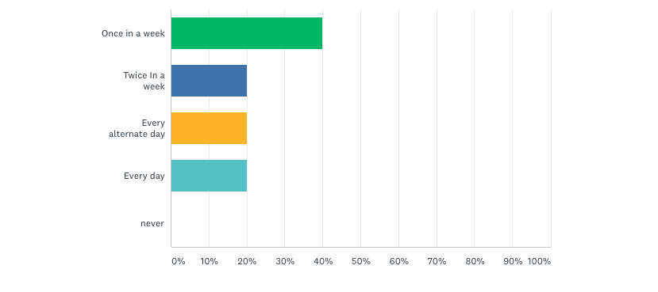
How Often Do You Cook

Slide 10
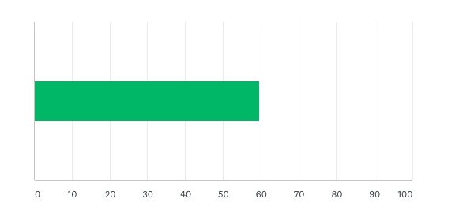
What Would You Rate Your Cooking Skills?

Slide 11
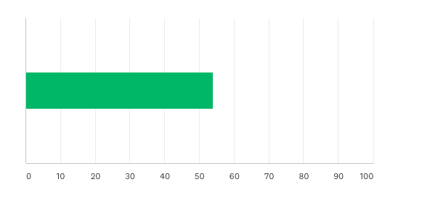
Willing To Cook For Others? (Get Paid for it too ☺)

Slide 12
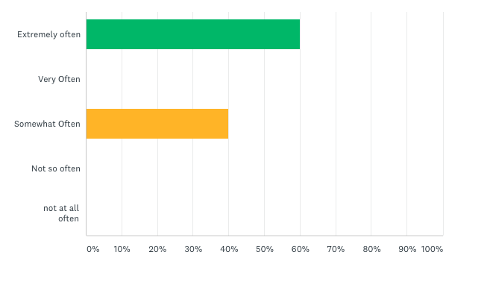
How Often Do You Order Food Online

Slide 13

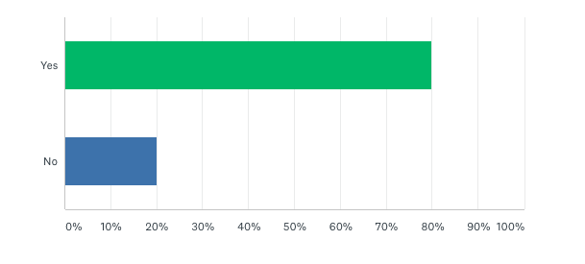
Do You Prefer Online Food Over Going To A Restaurant

Slide 14
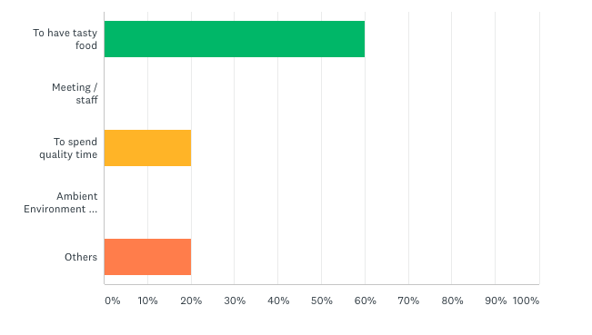
What is Most Primary Reason For You To Go To A Restaurant?

Slide 15
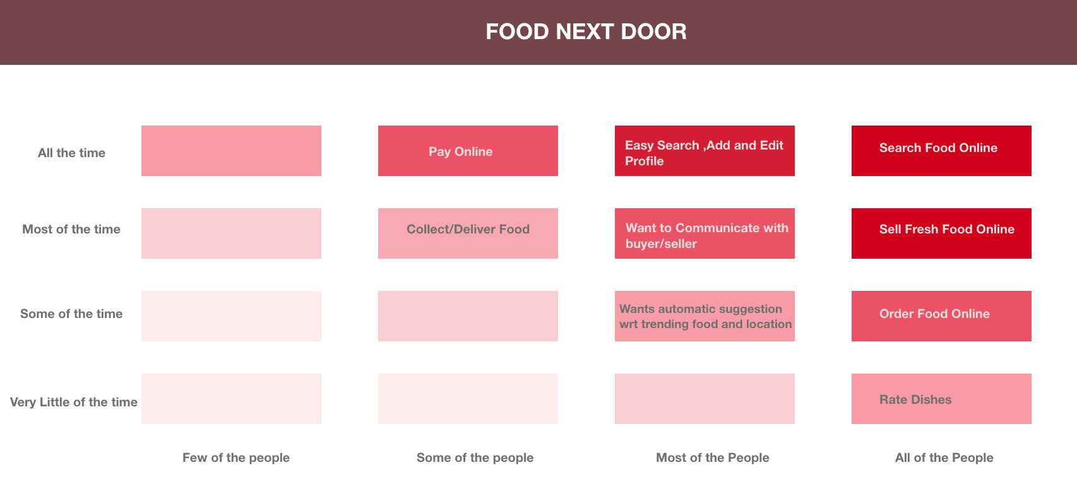
RED ROUTE

Slide 16






IMPLEMENTATION
Front-End
Back-End

Slide 17
FEATURES
User Authentication
Order The Cart Contents
Search For a Specific Dish
Sign Up As A Chef
Modify Contents In The Cart
Add Your Own Dish

Slide 18


STATE
CONSTANT EVOLUTION GLOBALLY AVAILABLE
Redux
PostgreSQL

Slide 19
DEMO

Slide 20
Arpith – Data Logger
Think A Loud
TESTING
Scenarios To Perform
Gunjan - Moderator

Slide 21
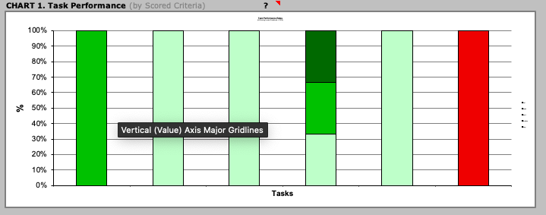
Task Performance

Slide 22
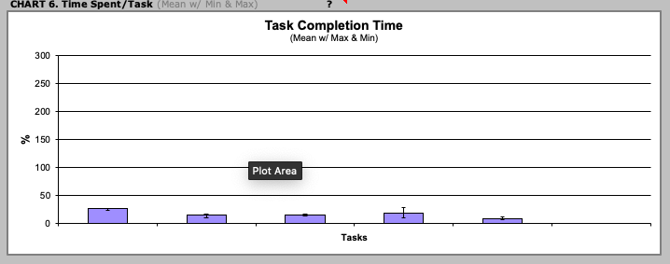
Task Completion Time

Slide 23
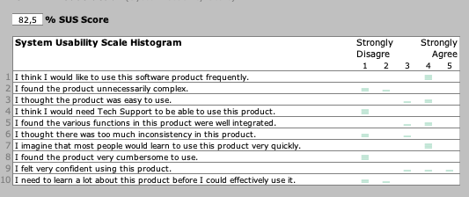
SUS Survey

Slide 25
LESSONS LEARNT
Design Aspects
Technical Implementation
Technical Testing
Usability Testing

Slide 26
THANK YOU!!!

